Slide 1

Heart Attack
Prediction Model
By:Mathieu Cadotte, Jessica Trusler, Robert Bernstein, Sweta Virani

Slide 2
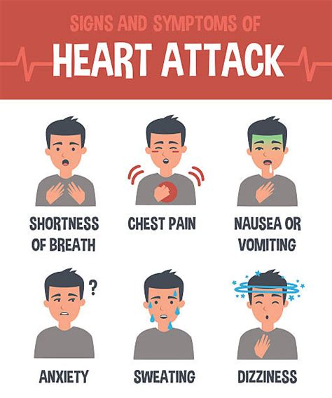
Our Objective
Develop a predictive model using machine learning algorithms to accurately identify individuals at risk of heart attacks
Success will be measured by the model's ability to accurately predict which observations have an increased chance of heart attacks
The models overall goal will be to contribute to early detection, prevention, and improved patient outcomes in the fight against cardiovascular diseases.
Notes:
Develop a predictive model using machine learning algorithms to accurately identify individuals at risk of heart attacks, utilizing the Heart Attack Prediction dataset.
This aims to improve early detection, intervention, and preventive measures to reduce the global burden of cardiovascular diseases.
Success will be measured by the model's ability to accurately predict heart attacks, its usability in real-world scenarios, and its potential to contribute to early detection, prevention, and improved patient outcomes in the fight against cardiovascular diseases.

Slide 3

The Dataset
Dataset from Kaggle: Health care: Heart attack possibility
The Dataset contains the data for 14 attributes used to predict heart attacks including:
Age
Sex
Chest Pain Levels (0-3)
Trestbps (resting blood pressure)
Chol
FBS (fasting blood sugar)
Restecg (resting electrocardiographic results)
Thalach (maximum heart rate achieved)
Exang (exercise induced angina)
Oldpeak (ST depression induced by exercise relative to rest)
Slope (the slope of the peak exercise ST segment)
Ca (number of major vessels (0-4) colored by fluoroscopy)
Thal (defect)
Target (the predicted attribute)
https://www.kaggle.com/datasets/nareshbhat/health-care-data-set-on-heart-attack-possibility?select=heart.csv

Slide 4

Models Implemented
Logistic Regression
Support Vector Machine
Random Forest Classifier
Decision Tree
Neural Network

Slide 5
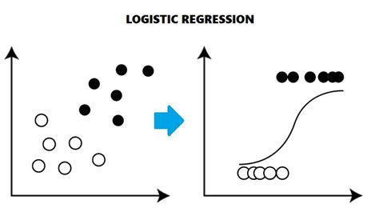
Logistic Regression
Logistic Regression was used to evaluate if a relationship existed between a binary outcome variable i.e. less or more chance of heart attack ( 0 or 1) and a group of predictor variables i.e heart attack diagnosis attributes
Base model accuracy was 75%
To optimize the model further, feature importance scores were calculated , various combinations of 3 low score features ( slope, fbs, age ) were removed but there was marginal increase , no change or reduction in the accuracy of the model

Slide 6
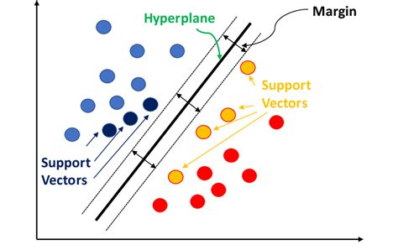
Support Vector Machine
Support Vector Machine classification model ( kernel = linear ) was used product less or high chance of heart attack
Base model accuracy was 72%
Model was optimized by removing features with low feature importance score (fbs, age and slope) but it unchanged or reduced the accuracy of the model.
Logistic regression and Support Vector Machine (using kernel as linear) model for this data couldn’t be optimized for higher level of accuracy indicating data is not much linearly separable
Notes:
Kernel = linear with the intention to create a linear hyperplane

Slide 7
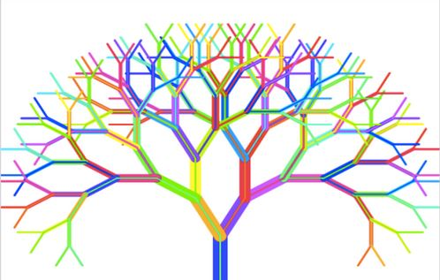
Random Forest Classifier
We used the random forest classifier because it will sample the data and build several smaller, simpler decision trees
When we combine the many slightly better than average small decision trees we create a strong classifier that has much better decision-making power
Notes:
It also has the benefits of being robust against overfitting because each weak classifier is trained on different pieces of the data and its robust to outliers and non-linear data

Slide 8
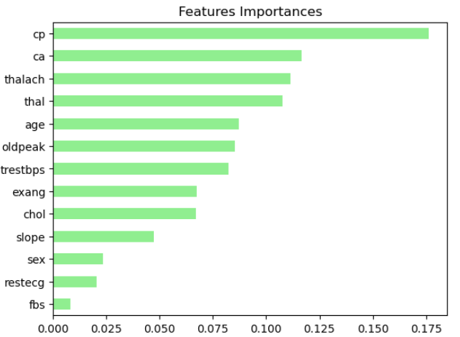
Random Forest Classifier
When we initially ran the model we received an accuracy of 80.32%, a recall of 80%, and a F-1 score of 80%
To further optimize the model we looked at the features importances and removed the three worst features (sex, restecg, fbs)
We also made other slight improvements by increasing the test size by 5%, making the class_weight = “balanced”, and by performing oversampling with the RandomOverSampler
These adjustments optimized the model and resulted in an accuracy of 83.1%, a recall of 82%, and a F-1 score of 83% in our final model

Slide 9
Decision Tree
The Decision Tree was used to gain insight into the decisions the model makes as it lays out all possible outcomes.
To optimize the accuracy of the model the Fasting Blood Sugar(FBS) column was dropped.
The Tree had an accuracy of 75%
Cross Validation was also used to improve the accuracy an additional 5%

Slide 10
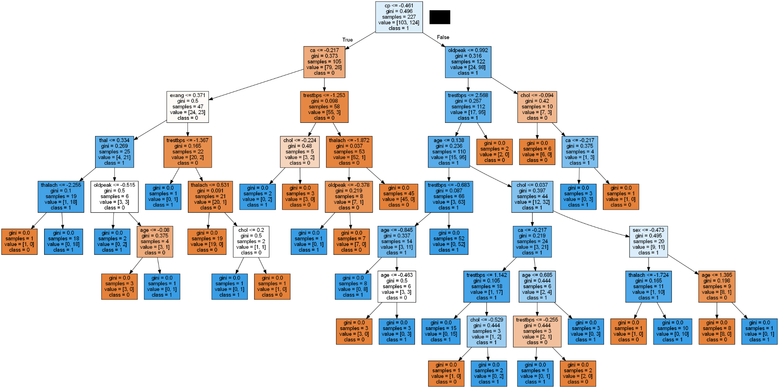

Slide 11
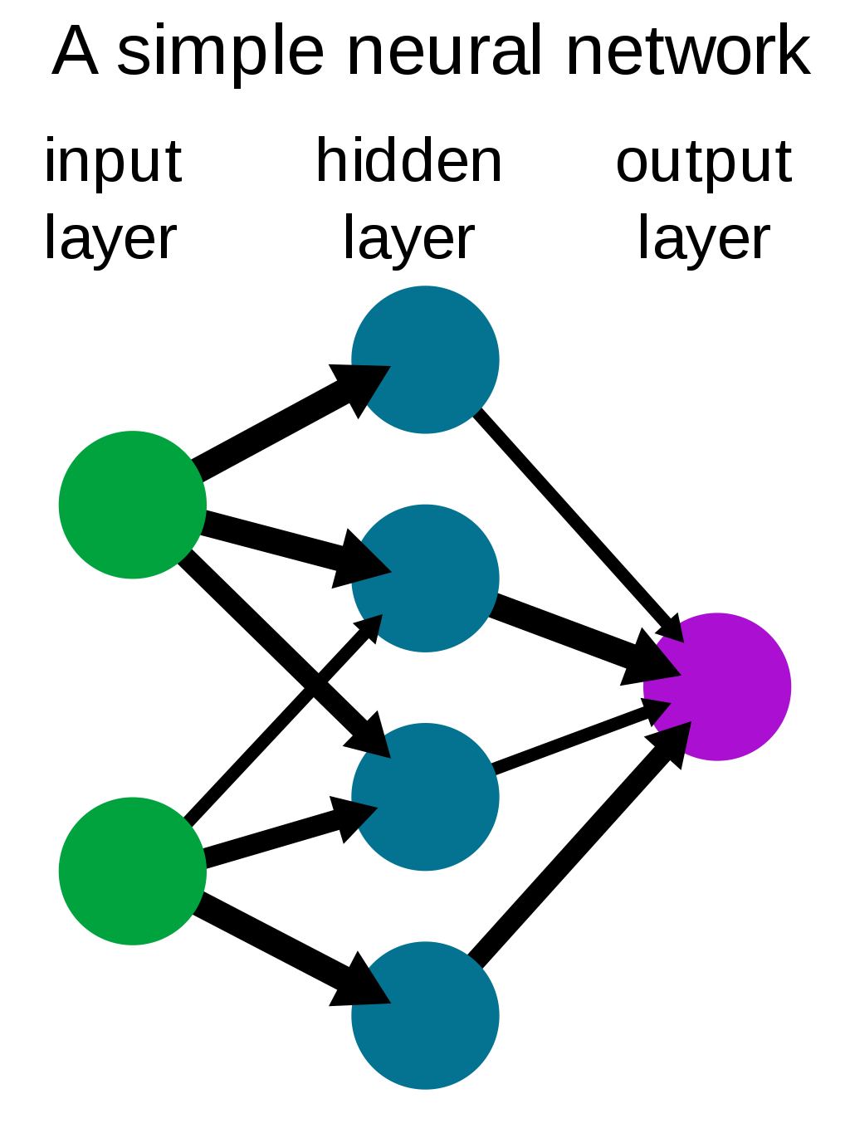
Neural Network
Neural Networks are very flexible and adaptable, making them a great choice for almost all data sets
Most optimal using 75 Epochs and 2 hidden layers
First layer contained 9 nodes, second contained 6
Increasing nodes at time changed accuracy
Best accuracy recorded was 78%, attempted dropping columns, dummies and more layers/epochs
Difference between balanced accuracy and model accuracy
Matrix came out skewed most runs
Notes:
Tried three layers, also tried 150 and 20 epochs Increased nodes, didnt improve

Slide 12
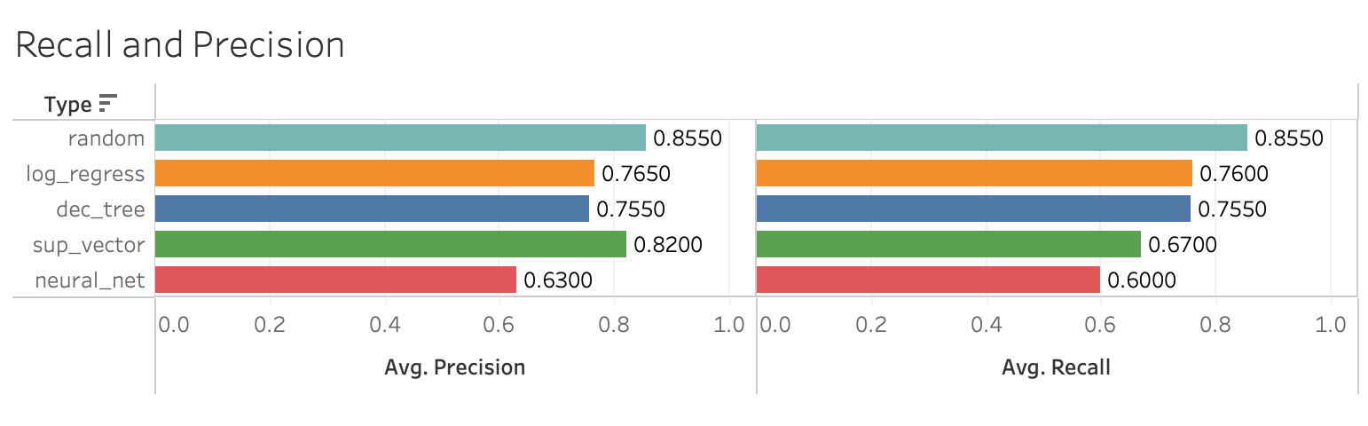
Model Comparisons

Slide 13
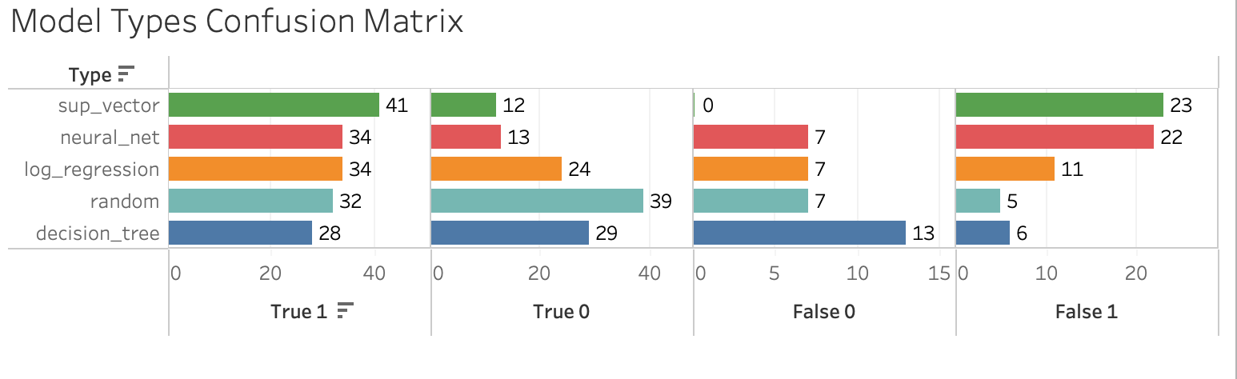
Model Comparisons

Slide 14
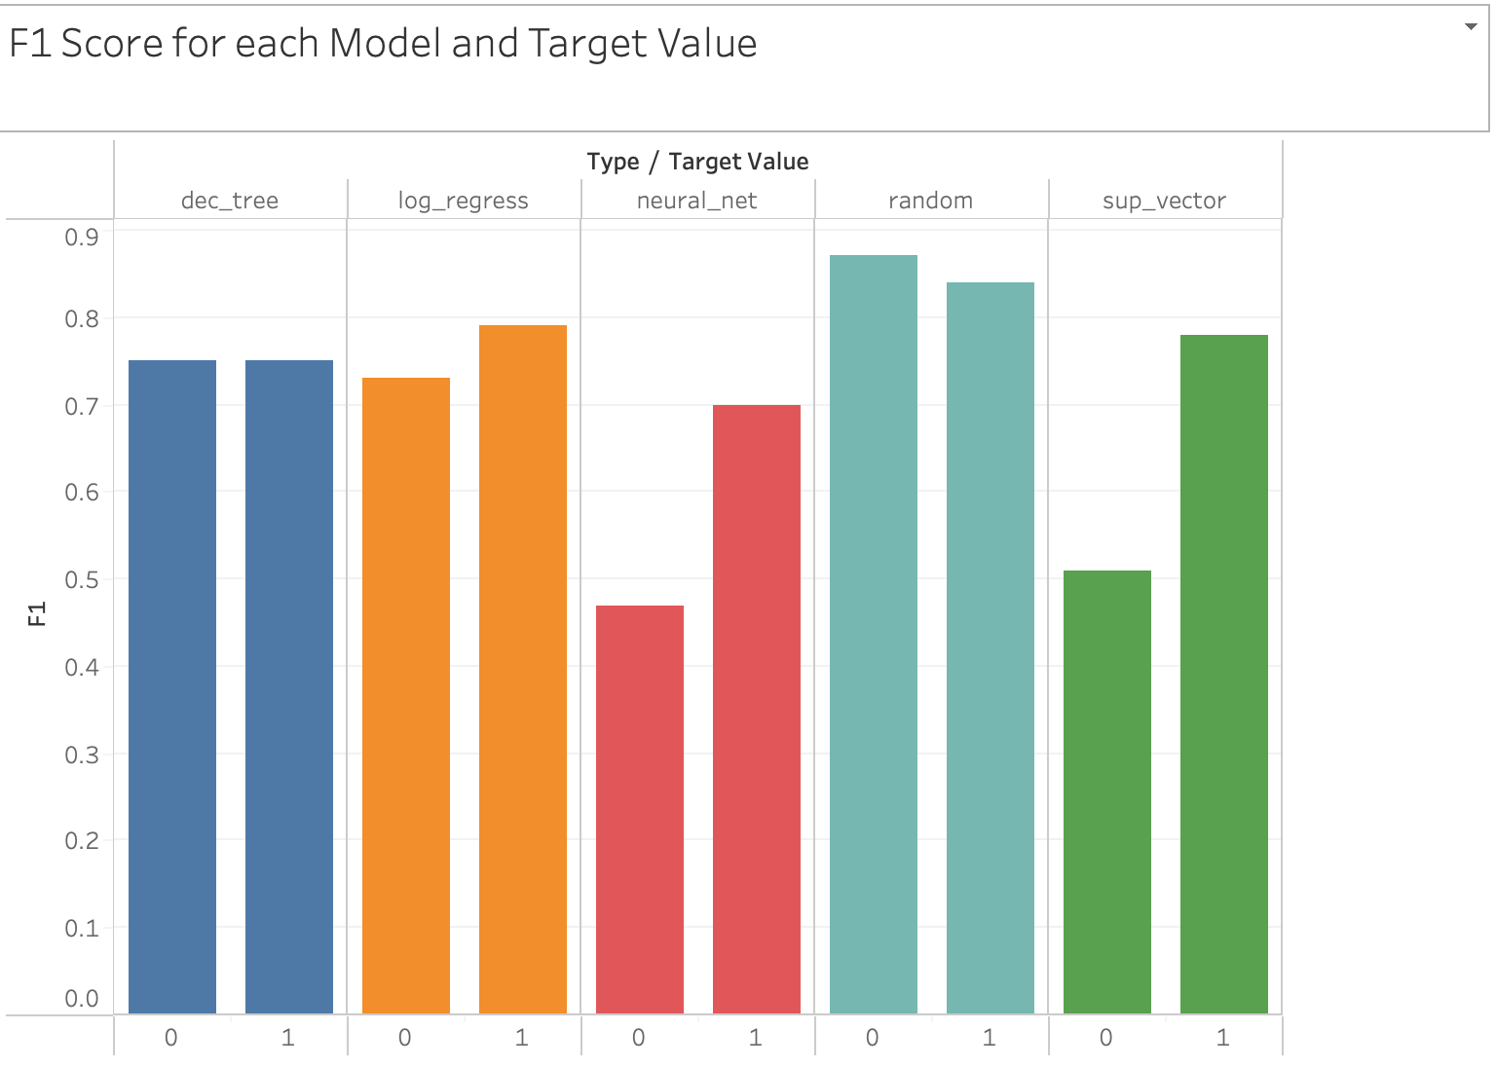
Model Comparisons

Slide 15
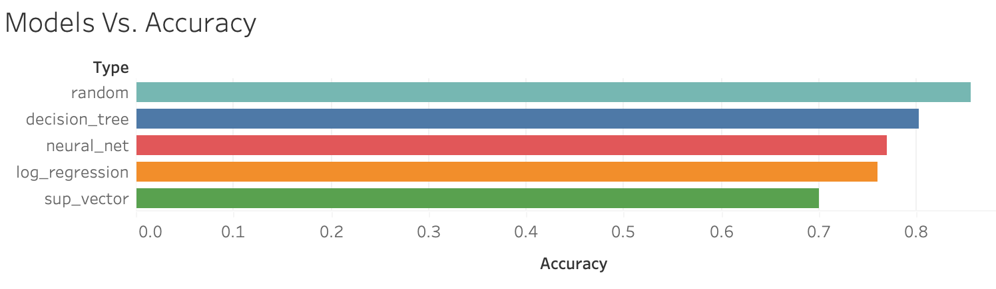
Model Comparisons

Slide 16

Limitations
Our biggest limitation was that there were only 303 people in our dataset. With more observations we would have been able to further optimize the model and produce a higher accuracy
Another limitation was the distribution of sex’s. Out of the 303 participants in the dataset only 32% were women which could have led to false positives or true negatives.
The general data on women was off and could lead to bias

Slide 17
Key Takeaways and Next Steps
As illustrated by the feature importances in the previous slide chest pain rankings were by far the biggest indicator of heart attacks
The most successful model was the Random Forest Classifier because many slightly better than average small decision trees we create a strong classifier that has much better decision-making power
One of our next steps would be to get more data to hopefully increase the accuracy and generalization of our model
We would also try to use more methods to optimize our models such as hyperparameter tuning and further looking at depth and the # of trees in the Random Forest
Notes:
Next Steps

Slide 18


